Slide 1
eProject SEM 4 Alluring Decors
Class: ACCP 201605L
Faculty: Mr. Vo Thanh Son
Group: Unknown Group

Slide 2
Objective
The Alluring Decors website is the solution, in which client can advertise with a full span, with images, business management, etc. Also they introduce new tasks and they can advertise the accomplished tasks.
Languages and Frameworks: Java Server Faces, Javascript, HTML, CSS
Library: Bootstrap, jQuery, Sweet Alert

Slide 3
Library
Bootstrap
Version: 3.3.7
Home page: http://getbootstrap.com/
Purpose: Design
Component and CSS: Navigation, input groups, HTML elements styled and enhanced with extensible classes, and an advanced grid system

Slide 4
Library
jQuery
Version: 2.0.0
Home page: https://jquery.com/
Purpose: Manipulation data and GUI
Function: Validation data, manipulate / transform the data returned by the server use ajax, manipulate form GUI, etc.

Slide 5
Library
Sweet Alert
Version: 1.0
Home page: http://t4t5.github.io/sweetalert/
Purpose: Show alert dialog box
Function: Show alert message, confirm box, warning box , etc.

Slide 6





Website Functions
Shows official announcements and information
Handles service requests
Manages company’s data and information
Handles user feedbacks
Handles billing and payment process

Slide 7
Conclusion
The group has designed a complete website provides the customer with the ability to advertise their works and manage their business.
The group has gained more experience, knowledge about designing website and teamwork skill.
With the results achieved of this project, the group will continue to improve the site and repair the deficiencies to improve the website and develop a website with database in order to realize the project.

Slide 8
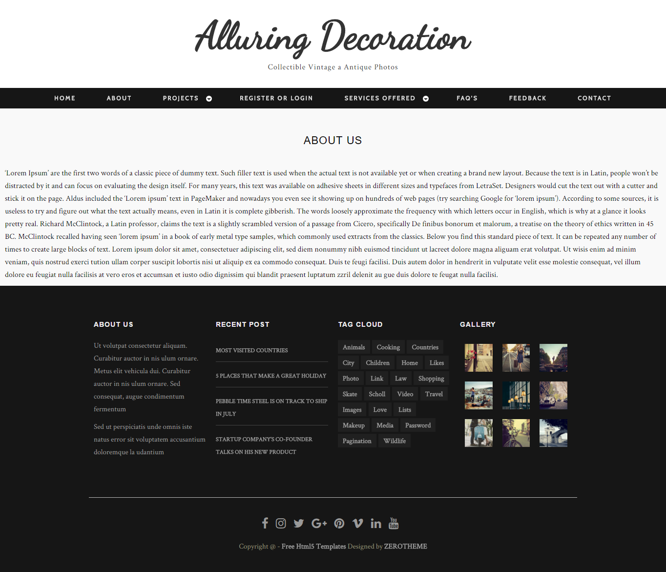
Demo

Slide 9
Thank you for your listening.

